Slide 2






Slide 3








Slide 4




Slide 5




Slide 6








Slide 7
































Slide 8

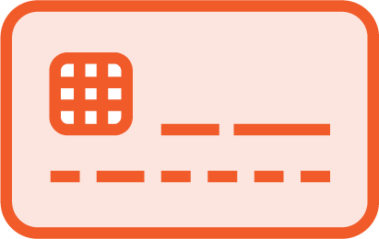
















Slide 9










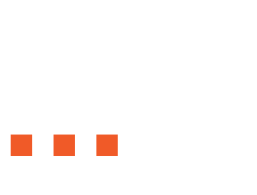










Slide 10
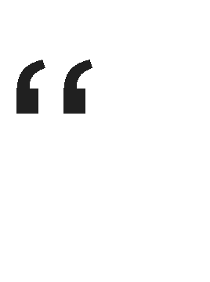





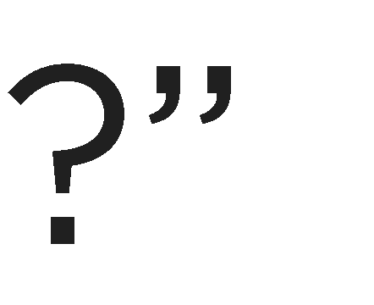

Slide 11
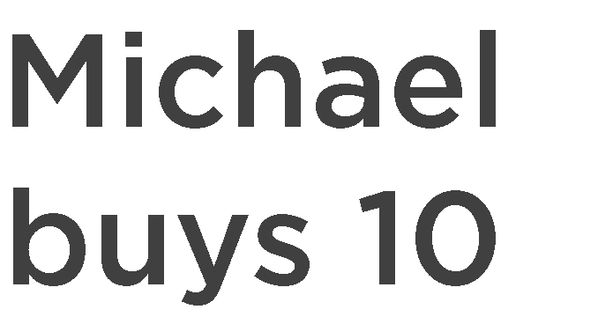











→

Slide 12





→

Slide 13















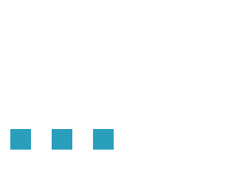
→
→
→

Slide 14





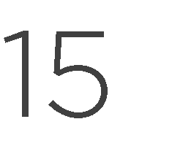




Slide 15





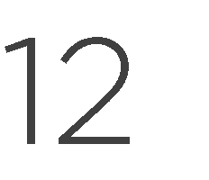

Slide 16



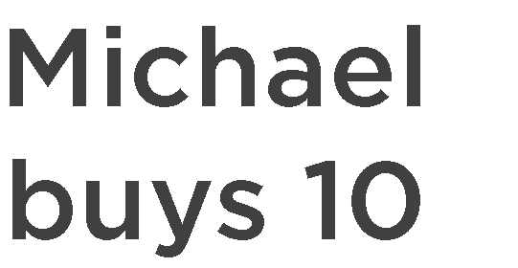






































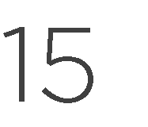


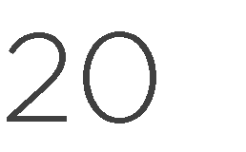
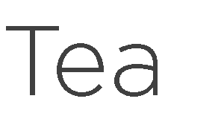




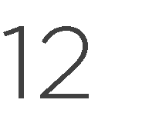
→
→
→

Slide 17
→
Scenario: Michael gets a free smoothie
Given Michael is a Morning Freshness member And he has bought 10 "Banana” smoothies When he orders another "Banana” smoothie Then his smoothie should be free

Slide 19








Slide 20
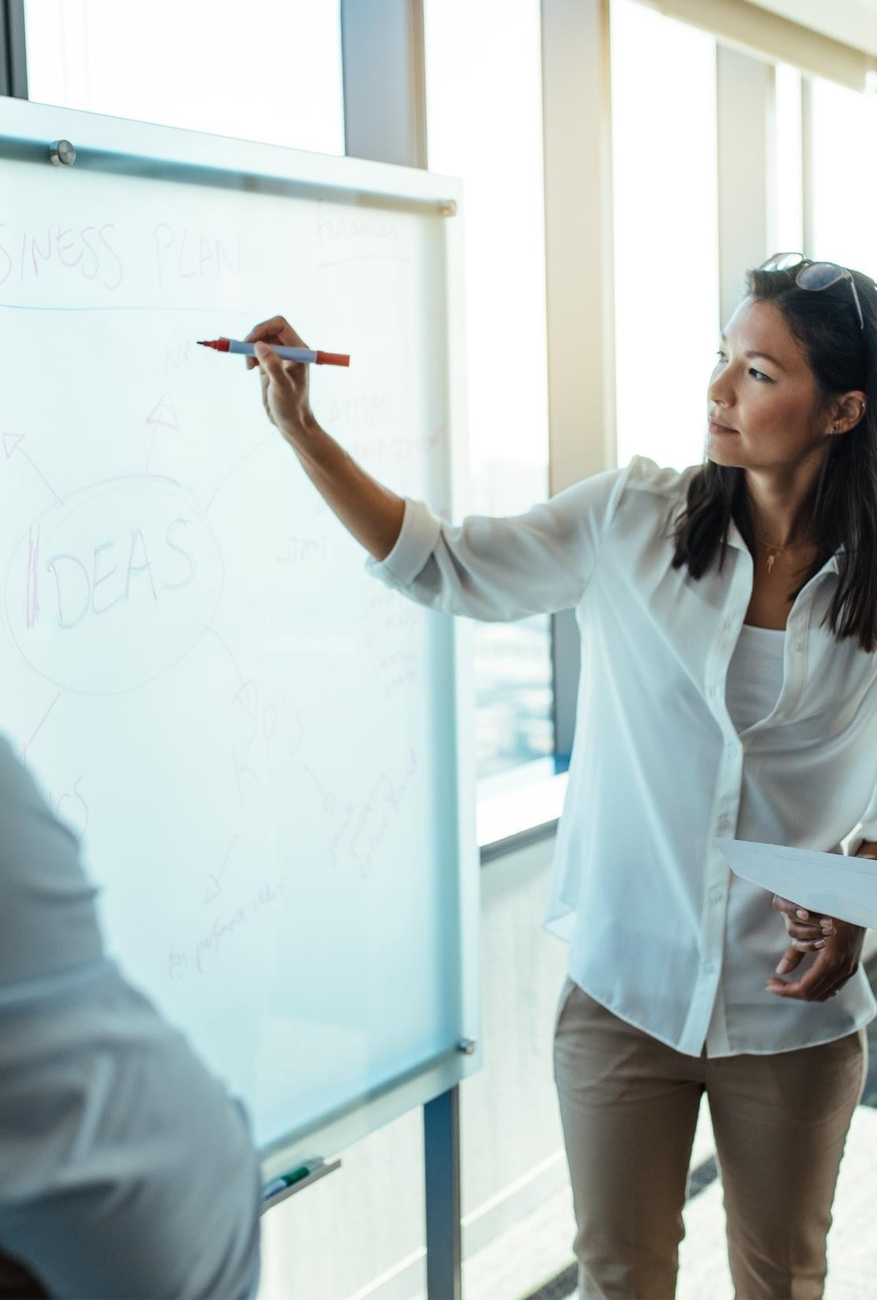








Slide 21
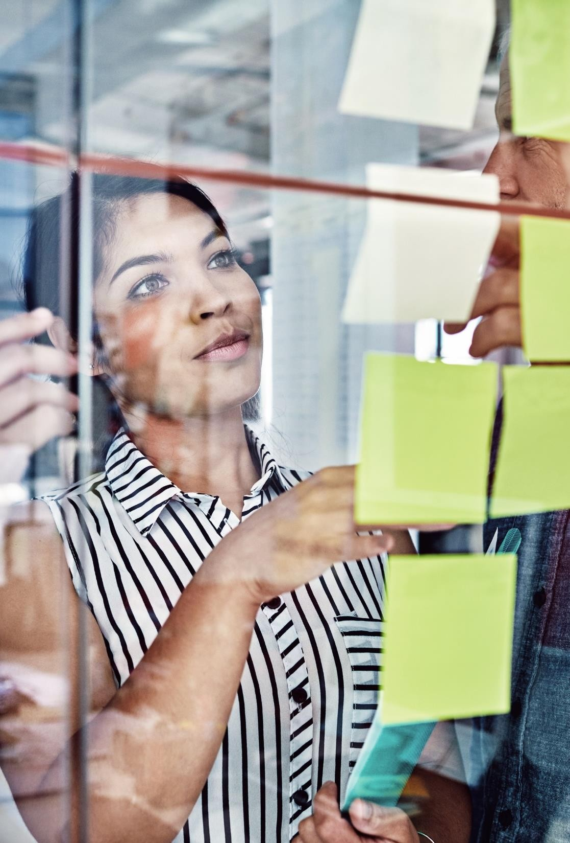





Slide 22


















Slide 23
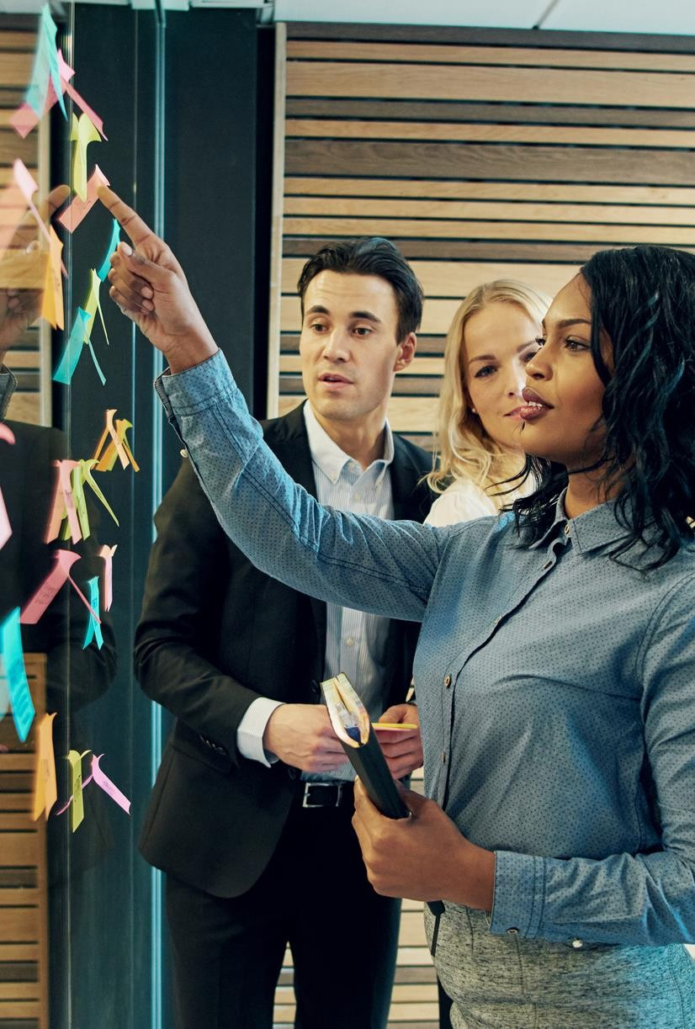






→
→
→

Slide 24
→
→
→

Slide 25




-
-
-

